Slide 1
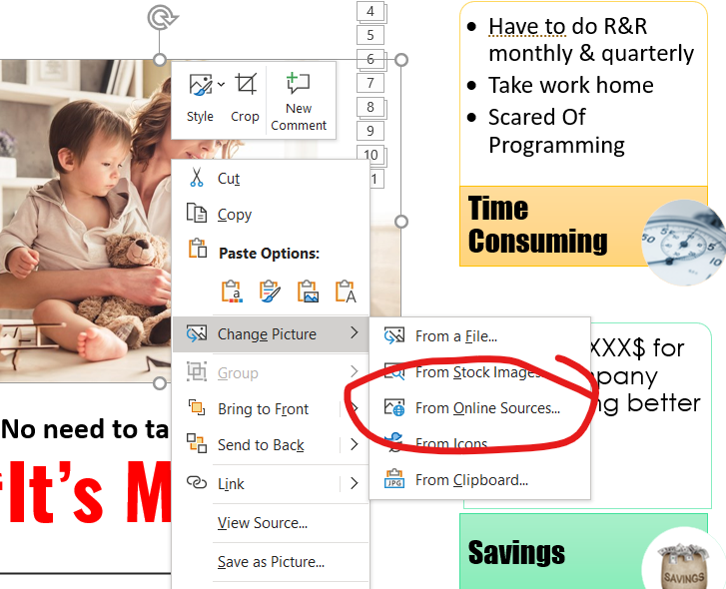
Success Story Presentation Template
How to use this template
Follow the instructions on the next slide to create your presentation.
Remember a PowerPoint is a visual for your presentation. The words on each slide should serve only as talking points (rather than everything you are going to say).
Images and graphics add interest; be sure to add them to your slides when appropriate.
Use “Search Online Pictures” feature to create beautiful presentations.

Slide 2

SUCCESS STORIES
UPSA Check list
Audience – ( Peer/Execs/Customer)
Parts | USUAL | UNUSUAL
Problem ( Process Name & Steps ) | Have to R&R Every month It takes a lot of time | This meant that she was doing it at home beyond work time
Solution | Made a bot | Being a non programmer I was able to develop a bot
Achievement | Work got done quickly Saved time and effort | I saved XXX$ for the company and doing better work Since then built 3 unusual bots automated 80% of a manual task Saved 2 hours per day 50% productivity increase

Slide 3
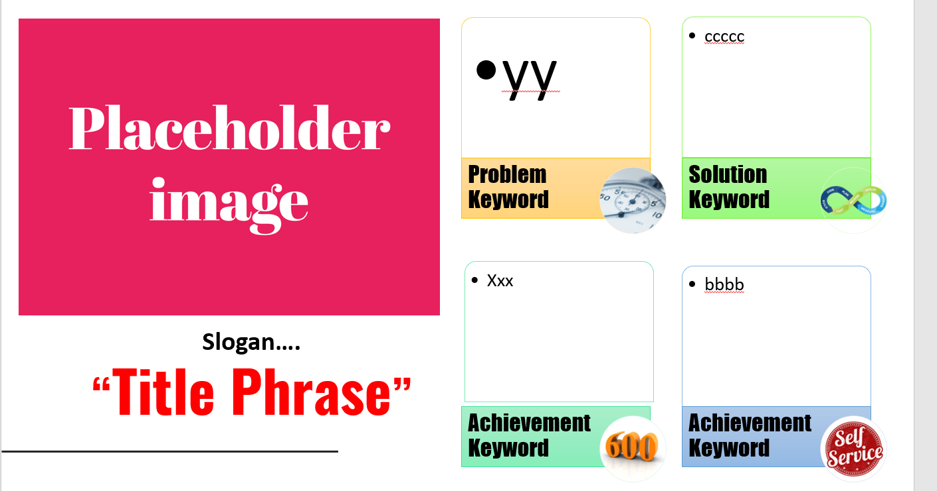
Story Template

Slide 4

Time Consuming
Growth Mindset
Have since then built 3 more bots
Savings
Bright Future
I saved XXX$ for the company and doing better work
Learnt UI Path programming
Had to do R&R monthly & quarterly
Take work home
Developed a mindset to become a programmer
Scared Of Programming
I have just begun my journey wait for more.
Saved 2 hours per day
50% productivity increase
Automated 80% of a manual task
No need to take work home
“It’s My Life”

